Slide 1


Labs of Physics for Engineers
Newton’s Second Law
Physics Experiment Teaching Center
Notes:
通过实验验证牛二

Slide 2
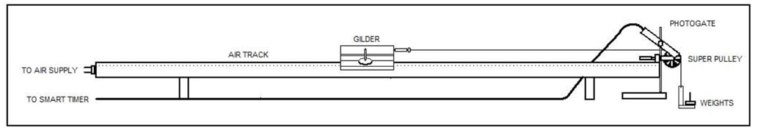
Aim
To verify Newton’s Second Law of Motion by measuring the velocity and acceleration of the Glider
Notes:
牛二阐述的是物体受力与加速度之间的关系，滑块施加外力，测量滑块在气垫导轨上的加速度来验证。

Slide 3
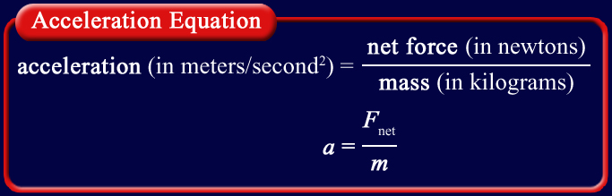

Theory
In this equation, a is the acceleration, m is the mass, and F_{net} is the net force.
If both sides of the above equation are multiplied by the mass, the equation can be written this way:
Notes:
物体运动的加速度的大小是与所受的外力和物体本身的质量都有关，质量越大，相同外力下加速度越小。

Slide 4
Units
Units of Force = Newtons (N)
SI units for mass is kg
SI units for acceleration is m/s²
1 Newton (N) = 1kg * m/s²
Notes:
实验报告上都采用国际标准单位来记录数据。

Slide 5
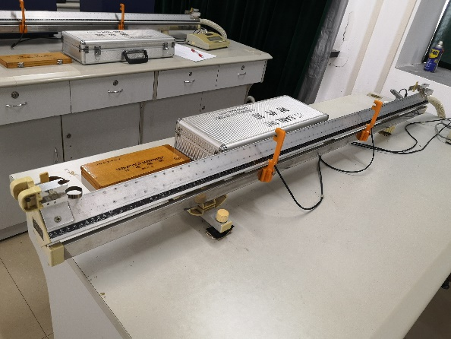
Apparatus
Notes:
实验装置，通气减少滑块的摩擦力。两个光电门

Slide 6
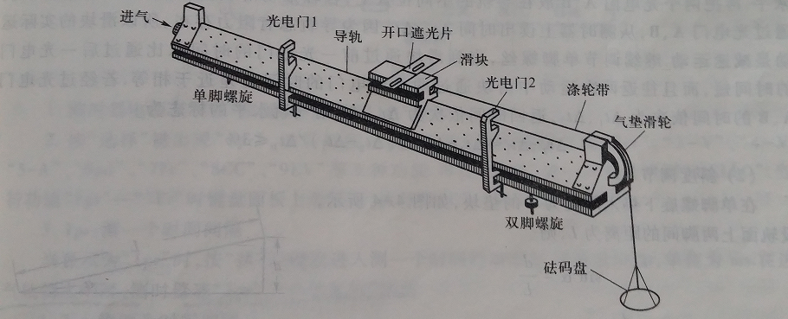
Apparatus

Slide 7
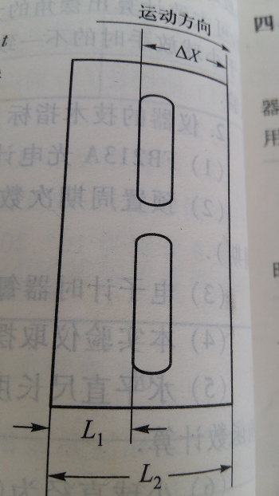
Velocity Measurement
The measurement of velocity
Notes:
要测定物体的速度，只需测出通过已知距离 所需的时间 即可。在气垫导轨的滑块上安装一个开口遮光片，使滑块在导轨上运动，并进入设在气轨上某位置的光电门。当开口遮光片的前缘遮蔽光敏管时测时器开始计时，当开口遮光片的后缘再遮蔽光敏管时测时器停止计。测时器上显示的数字即为开口遮光片移动 距离的时间。

Slide 8
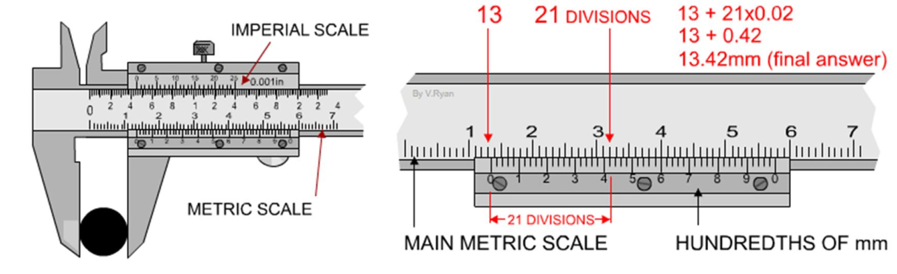
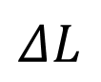
Vernier Caliper
$$ΔL$$
The measurement of

Slide 9
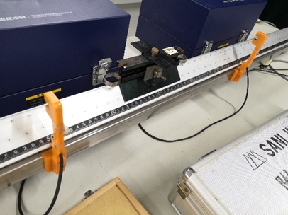
Acceleration
The measurement of acceleration
x₂ - x₁ is the distance between the two photogates.
Notes:
若滑块受一恒力的作用，则它将作匀加速运动，在气轨上 和 位置各放置一个光电门。分别测出滑块通过两光电门位置时的速度 和 ，那么滑块的加速度为

Slide 10
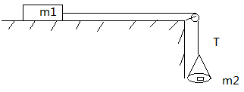
Free-body Diagram
Newton’s Second Law of Motion:

Slide 11
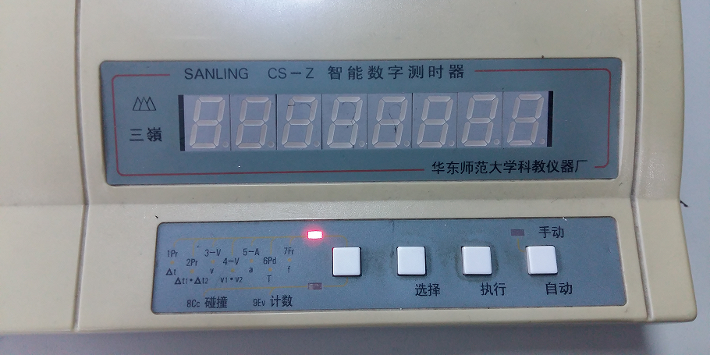
Smart Timer

Slide 12
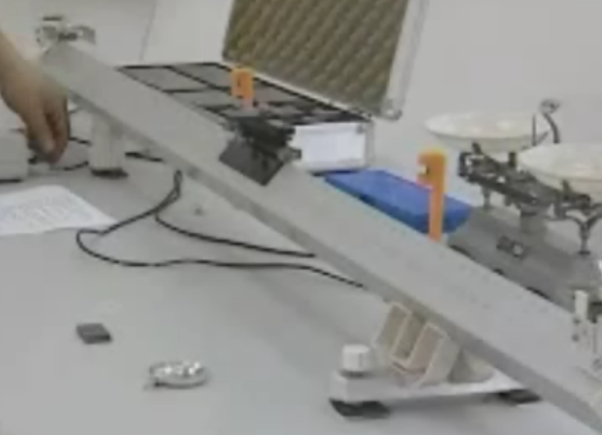
Procedure
Coarse adjustment:
Notes:
粗调：打开导轨的开关，再放滑块(因为滑块与导轨之间仍然有摩擦力)，需要调节导轨底下三个螺钉，目测使得滑块基本保持不动(往左滑代表右边偏高，往右滑代表左边偏高)。

Slide 13
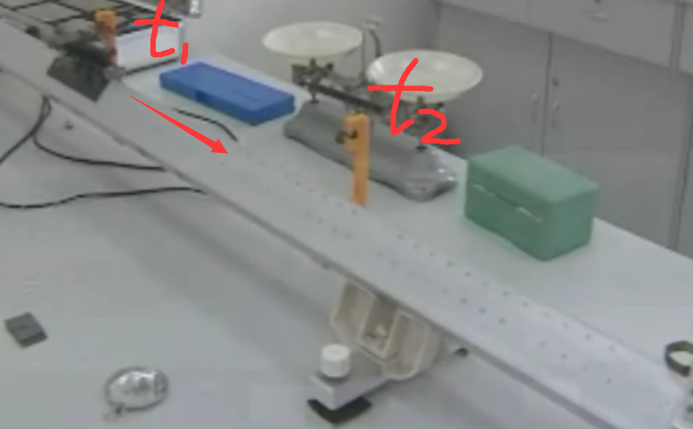
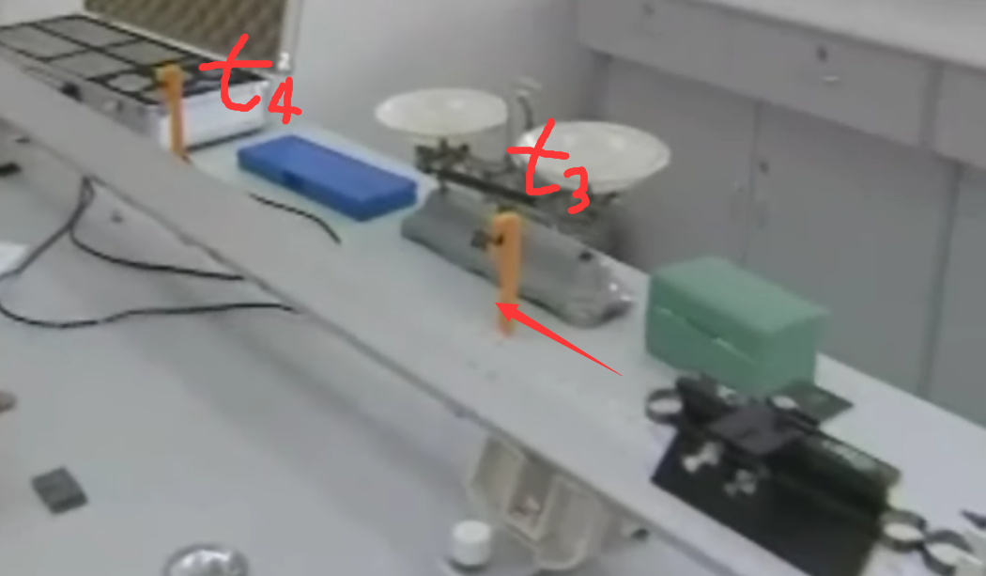
Procedure
Fine tuning:
t1=33.653ms
t2=34.655ms
t4=60.174ms
t3=59.738ms
$Requirements: (t_{2}−t_{1}) ≈ (t_{4}−t_{3})$ & (t₂-t₁)/t₁ ≤ 3%
Notes:
t2-t1≈t4-t3：这里近似约等于号要体现在计时器上的量化数值，这里经验值大约是往返时间间隔|(t2-t1)-(t4-t3)|在0.2ms到0.3ms之间。具体哪个是t1，t2，t3，t4? 可根据滑块运动方向来定义。要会根据这两个差值大小来判断哪边高哪边低？比如若|t2-t1|这个差值较大，代表滑块做“上坡”减速运动，反之则是“下坡”加速运动。如下图的“上坡”举例：
两个光电门要先移到整个导轨的中间位置。因为如果太靠近导轨两端或者互相靠得太近，会出现再次经过光电门时，计时器没有显示时间数据的错误结果。(注：经过光电门的时候速度如果太快，计时器芯片再次显示的延时大约0.2ms，故无法显示)

Slide 14
Procedure
Transfer 25 grams from the weight box onto the Mass Holder. Record the mass of the Mass Holder and the added mass as m_{a}. The gravitational force, due to m_{a}, causes the glider to be accelerated. This acceleration can be measured electronically by using the Smart Timer.
Turn on the Smart Timer with two photogates connected to plug 1 and 2 on the Smart Timer. Set the Smart Timer to 2pr. After pressing the Execute button, the timer is ready for a measurement. (The distance between two photogates should be approximately 50 cm, while the initial positions of the Glider should keep the same in multiple measurements)
Notes:
(The distance between two photogates should be approximately 50 cm, the initial positions of the Glider should keep the same in multiple measurements)

Slide 15
Procedure
Pull the Glider approximately 120 cm from the pulley with allowing the mass holder to hang up to about 20 cm below the pulley. Turn on the air supply. When the Glider is in place with the air supply on, the Execute button can be pressed and the Glider will be released. Press the Execute button and simultaneously release the glider so that it runs the track for an accurate result.
Record the figure on the screen of the Smart Timer due to the combined mass of the added object and the Mass Holder. Repeat this measurement five times until a consistent set of results is obtained with making sure that the Total Mass of the system remains constant.
Notes:
(The distance between two photogates should be approximately 50 cm, the initial positions of the Glider should keep the same in multiple measurements)

Slide 16
Procedure
The Glider does not need to travel the length of the whole track to take the reading and should be stopped manually once a figure appears on the screen or before hitting the damper at the pulley. (Ensure that the laser photogate is accurately being interrupted by the metal plate fixed on the Glider)
Measure the width of the metal plate fixed on the Glider for triggering the photogates by using a Vernier caliper.
Weigh the Mass Holder, the Glider and the added masses and record this as M_{T} , the total mass of the system.
Notes:
(The distance between two photogates should be approximately 50 cm, the initial positions of the Glider should keep the same in multiple measurements)

Slide 17
Experimental Results
ΔL= m x₂-x₁= m | Run number | Δt₁ (ms) | Δt₂ (ms) | v₁ (m/s) | v₂ (m/s) | Acceleration a (m/s²)
25 grams | 1
 | 2
 | 3
 | Average
20 grams | 1
 | 2
 | 3
 | Average
15 grams | 1
 | 2
 | 3
 | Average
10 grams | 1
 | 2
 | 3
 | Average
5 grams | 1
 | 2
 | 3
 | Average

Slide 18
Experimental Results
Total mass of Mass Holder & added masses m_{a} (kg) | Average acceleration caused by the total mass recorded in column 1. a (m/s²) | Gravitational force due to total mass recorded in column 1. F_{a} = m_{a} × 9.79 N

Slide 19
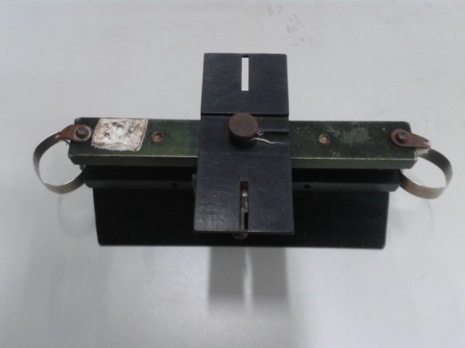
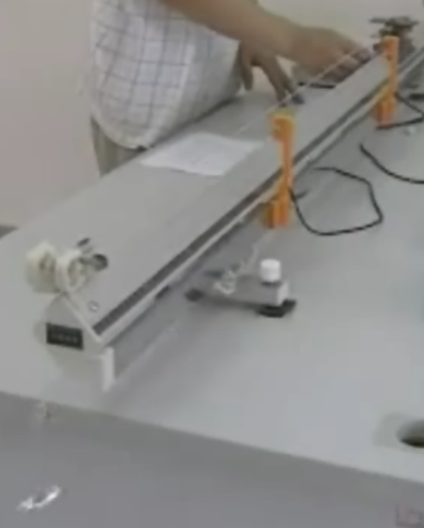
Precautions
√
×
×
√
Hanging
Notes:
(a)挂砝码盘的时候，细线应该挂在滑块上方的中间位置。(这是为什么？因为要求滑块的受力方向是沿着导轨平行的方向，不允许有其他方向的分力)
当滑块经过第二个光电门时，砝码盘不能触地；当实验开始滑块处于静止时，砝码盘也不能和导轨或实验桌互相依靠在一起，否则滑块刚开始运动就存在砝码盘与导轨的摩擦力，使实验误差增大。

Slide 20
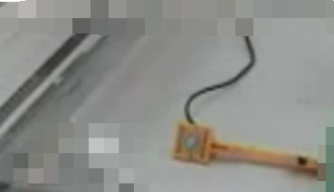
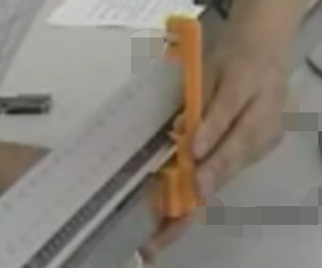
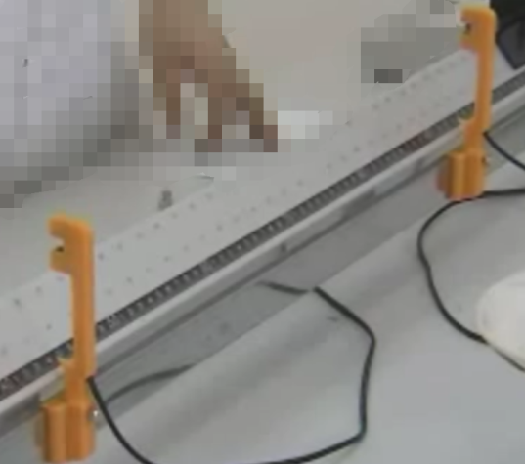
Precautions
Magnetic
50cm
Notes:
(b) 调整光电门位置时，要用力拖住下面部分，因为下面是磁铁吸紧，如果在上面用力，容易折断光电门；可以上下，前后调整；两个光电门要距离50cm，若距离太短，容易造成计时器延时显示不出来，若距离太长，容易由于滑块与空气之间的摩擦力增加而引入误差，因为摩擦力与空气的粘滞系数成正比，而粘滞系数又会随着速度不断增大而增大。

Slide 21
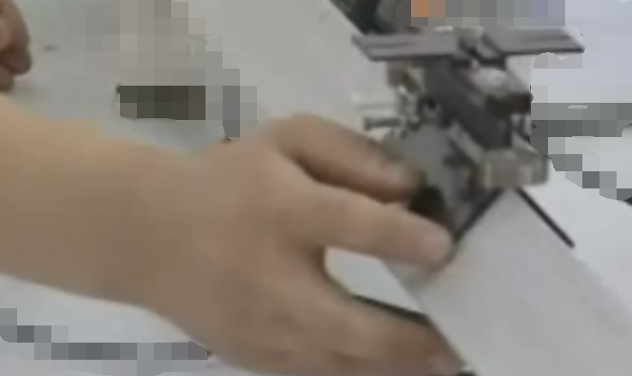
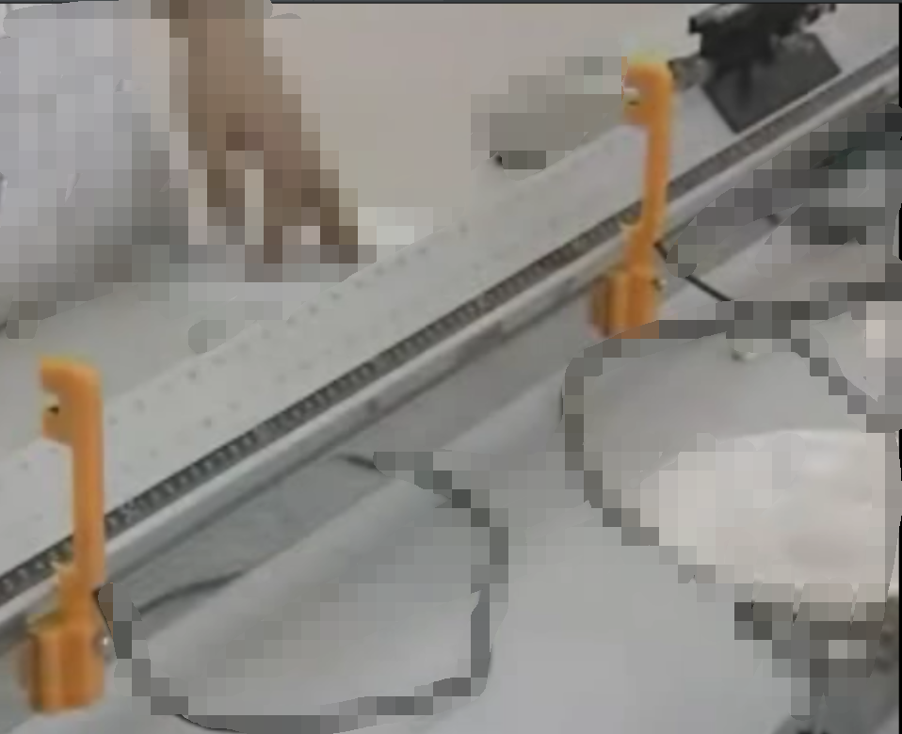
Precautions
×
20cm
√
PUSH
Notes:
(c) 滑块只能用手指轻轻靠住下边，然后轻轻放开或者推开，不能用手压住滑块移动，否则会使滑块与导轨之间产生较大摩擦力，抵消通气孔的作用力，是一种严重错误的操作；
滑块要放在距离两个光电门之外20cm左右的某个起始位置，这是因为需要留有一段适当的加速距离；
且每种情况的实验都要让滑块位于相同的起始位置，确保三种情况的初始条件都一样，才具有可比性。

Slide 22
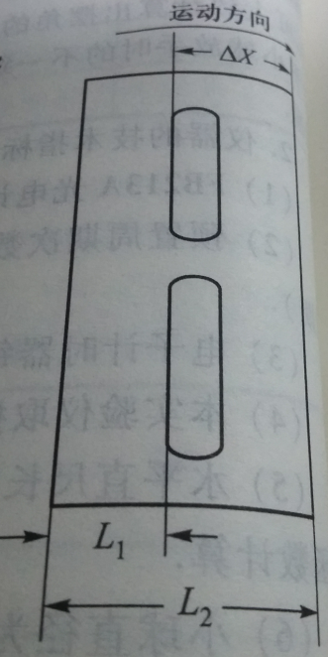
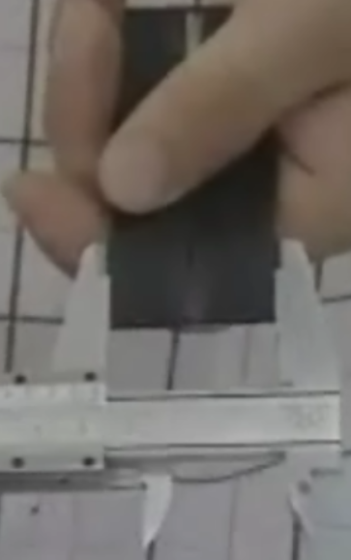
Precautions
Δx
Δx
From left to right to the photogate
From right to left to the photogate
Notes:
注意： Δx的定义与运动方向有关(左图代表从左往右经过光电门；若是从右往左经过光电门，则Δx应该如右图所示的，一般与左图Δx不等，需要重新测量)，用游标卡尺测量L2和L1,再相减得到Δx= L2 – L1。
遮光片与光电门壁之间的距离最好保持在1mm左右，若太远没有遮住感应的激光，计时器不显示数据，若太近与光电门壁发生摩擦，产生测量误差。

Slide 23
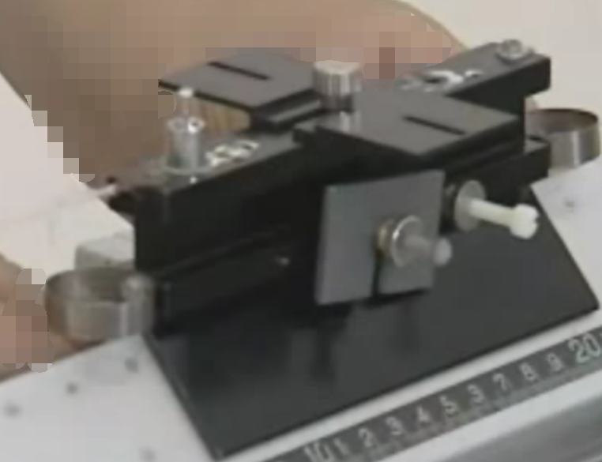
Precautions
Weight
Notes:
(e)两片加重块应该是锁紧在滑块两边，否则在滑块加速运动过程中容易不稳定而发生掉落；5g砝码应放在滑块正上方保持受力平衡。

Slide 24
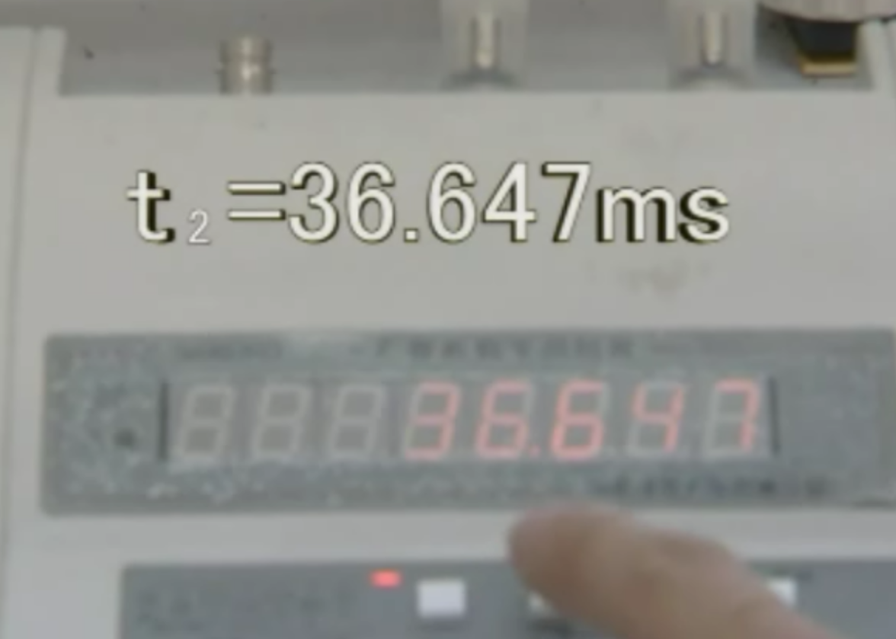
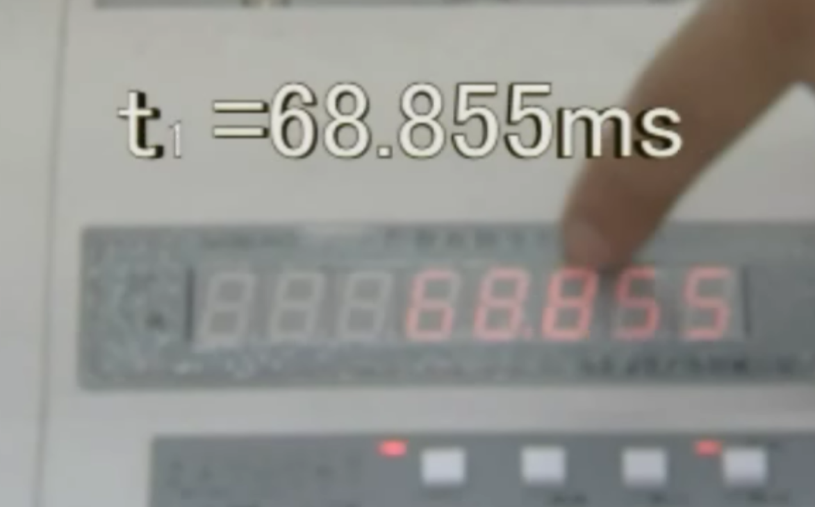
Precautions
Choose 1pr when fine tuning.
Choose 2pr when performing measurements.
Δ
Δ
Press“选择”，switch to Δt1
Notes:
(f)计时器的使用（单位是ms）
(1)选择(1pr)+自动复位+执行：细调导轨水平时使用，显示的时间数据会自动刷新(要记录在草稿纸上，以免数据丢失)
(2)选择(2pr)+手动复位+执行：进行测量时使用，显示的时间是指经过第二个光电门的时间间隔Δt2 ；要看经过第一个光电门的时间间隔Δt1需要按“选择”键来进行手动切换并记录到实验报告上(如下图)

Slide 25
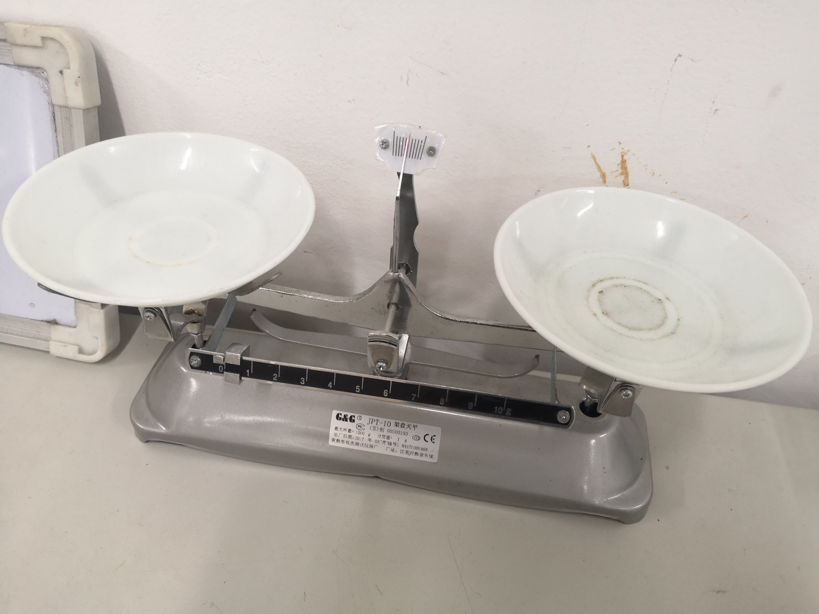
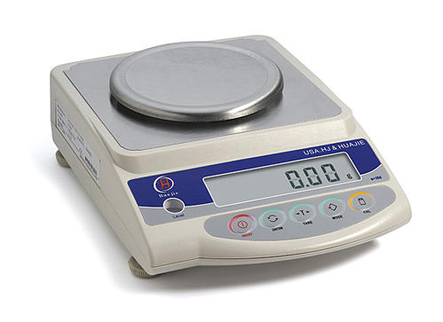
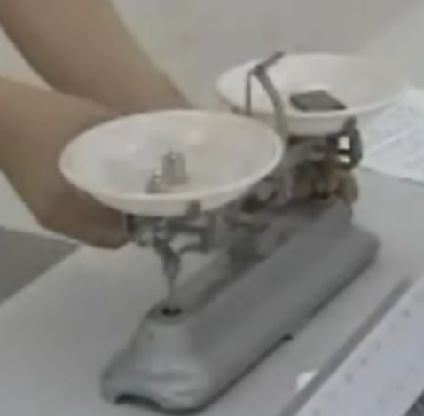
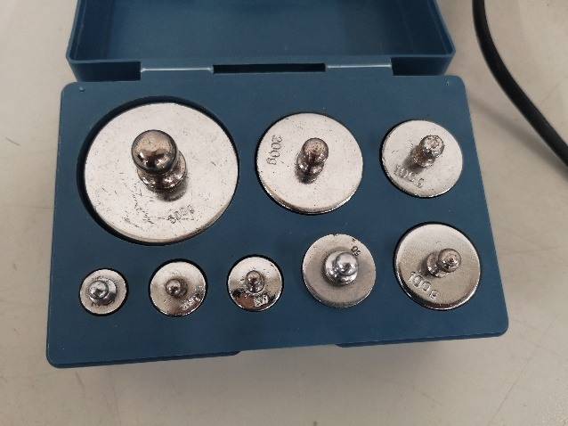
Precautions
Notes:
左边放物体，右边放砝码。
（1）测时器显示的时间以毫秒为单位，十进制单位换算时有效数字的位数不变。
（2）2克、5克的砝码当作常数，运算时有效数字的位数可不考虑。
（3）先通气源再放滑块，加减砝码、加重片时应取下滑块，做完实验先收滑块再关气源。
（4）同一组测每次滑块都放在距第一个光电门同一位置手放开，砝码盘稳定之后才能放手。

Slide 26
Graph
Draw a graph of the applied force, Fa, versus the average acceleration a of the whole system (Glider plus added masses plus Mass Holder), i.e. plot Fa on the y axis and a on the x axis.
Since Newton’s Second Law states that the acceleration is proportional to the applied force, i.e., F = ma, your data points should lie on a straight line.
Measure the slope of your graph and compare your measured slope to the expected value, which is the total mass of the system, M_{T} .

Slide 27
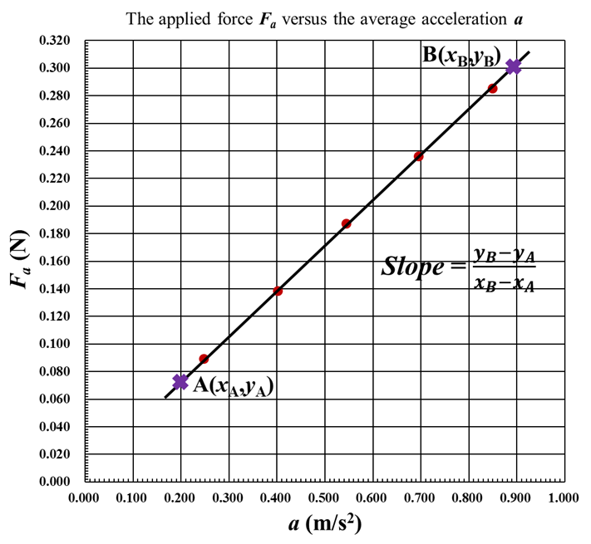
Graph

Slide 28
Conclusions
In no more than 100 words write a succinct summary of what you have done. State the goal and method of the experiment. State your main results, i.e., Did you find that the acceleration is proportional to the applied force, or not? What value did you get for the constant of proportionality? Are your results consistent with Newton’s Second Law? If your results are not consistent with Newton’s Second Law, can you suggest why not?

